Slide 1
PROJECT OBJECTIVES
PLATFORM DEVELOPMENT- Creating a user friendly platform to facilitate online sales for local vendors (textles,food,shawls,handicrafts)
VENDOR ONBOARDING- will be developing a streamline process for local vendors to register , list their product and manage their online stores
LOCAL LANGUAGE SUPPORT- as most local vendors will not be familier with English . Platform will support multiple local languages (Dogri,Kashmiri}
MARKETING AND PROMOTION- As we are collaborating with government so most of the marketing will be done by the government

Slide 2
OUTCOME THIS PROJECT
BY MAKING THIS PROJECT WE AIM TO BOOST ECONOMY OF JAMMU AND KASHMIR, PROMOTE LOCAL PRODUCTS AND PROVIDE A PLATFORM FOR VENDORS AND CUTOMERS.
THE MONTHLY UNEMPLOYMENT RATE OF JAMMU AND KASHMIR IS INCRISED UPTO 15%.WHICH IS HIGHEST IN INDIA. WHICH MEANS UNEMPLOYED PEOPLE ARE SEEN IN KASHMIR. Businesstoday.in
Despite of having immense art in Kashmir local vendors are not having any platform to showcase their talent because they are continuously harassed by government officials when they work off
Economy of jammu and Kashmir is project to increase 5-6%. In 2023-24. But it is sad to say that they are completely relying on Tourism sector. (Seaonal)

Slide 3
We are not thinking from SIH perspective. What if we actually collaborated with J&K. then the question arises that are we really providing them the solution they need.
Then we concluded that yes. This app not only will generate employment for local vendors but also will generate employment oppurtinities for delivery agents, customer care.

Slide 4
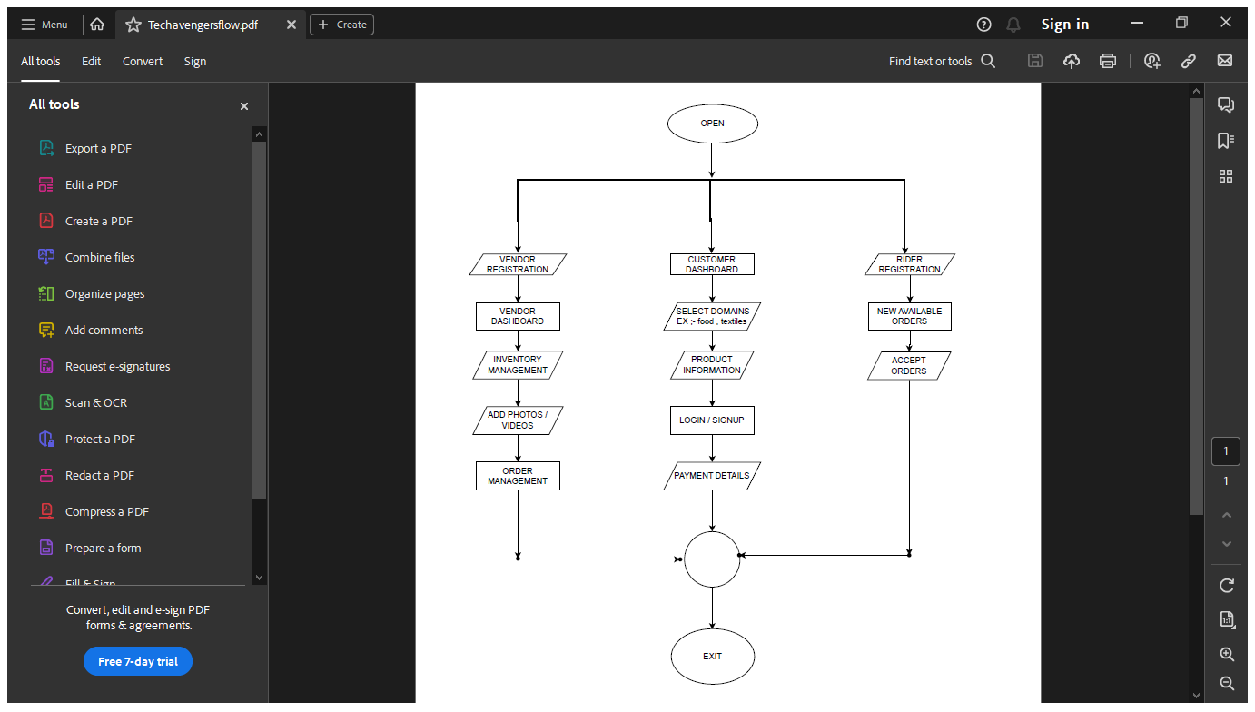

Slide 5
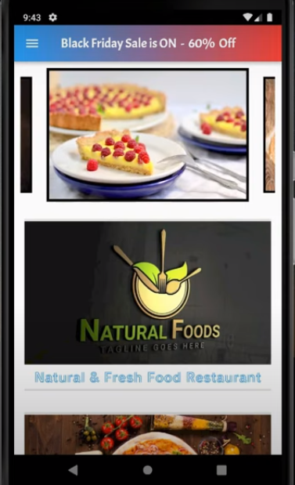
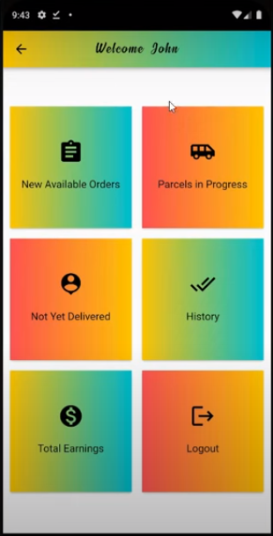
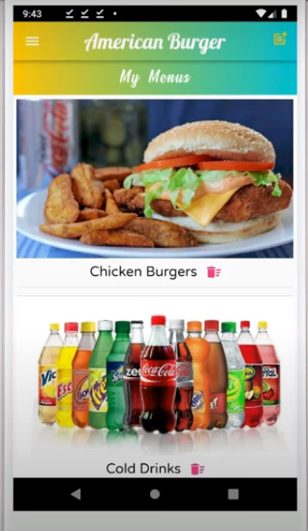
VENDOR POV
DELIVERY AGENT
CUSTOMER POV

Slide 6
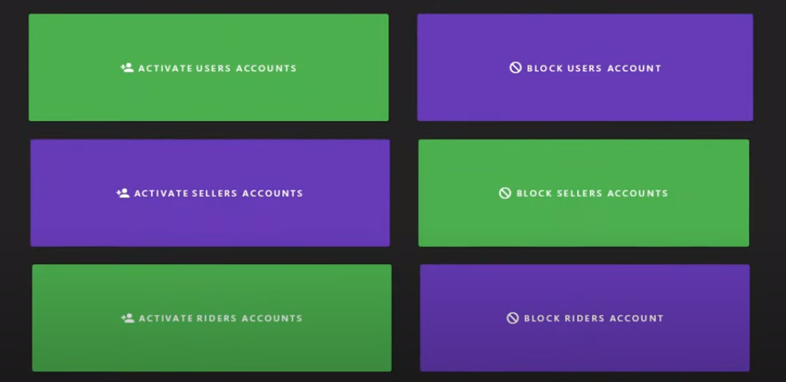
There will be an admin panel who will be having right to block/unbock account of vendors and riders incase of any fradulant things

Slide 7
USER EXPERIENCE
It is true that our primary objective is to provide platform to local vendors but we are also not compromising on User Interface(UI) of app as better UI will attract more user on app
A better UI will encourage user to spend more time on app.
It will lead to increased user satisfaction , engagement an business success
Compare myntra and ajio

Slide 8
USP (UNIQUE SELLING POINT)
USP Is the thing which makes our app different from existing app or competetors
Connecting communities- In a region which is culturally rich as Jammu And Kashmir, this app will differentiate itself from other by focusing on community building an preserving the unique heritage of region
App will feature a dedicated section for local artisans and craftspeople promoting rich handicrafts and traditional products.
Local Language support- App will be available in local language, making it accessible for everyone
Rating System - We will be adding a section in which users can rate local vendors.
SEPARATE VIDEO SECTION- Vendor can also add video of hand crafted products, so that asuraty of user will increased towards vendor

Slide 9
Future Scope
In future we want to spread this app all over India. in which products of Kashmir will be spread all over India.
We have taken this reference from app called SWEE DESI whch was featured in Shark Tank Season 1 .
Which delivered its sweet products all over India. It delivered sweets from Kolkata to Mumbai in less than 24 hours.
Tourism- In upcoming future we will be also adding tourism section in it so that people visiting Kashmir can directly book hotels from this app. But for now we are sticking upto local vendors only as main goal is to generate employment to them.
3 WAY AUTHENTICATON- We will be adding 3 way authentication to enhance security of app (pass,finger,face)
AI recommendation system- When a new visitor comes to app for the first time itself, at that time instance the system dosent know anything about user. But it still introduce the visitor to produce which are (top rated , best sellers). When something catches his eye is the time system learns more about user intent so it can directly offer similer product to user in real time.
As user comes after certain time period he gets personalissed recommendation.
This will lead for getting satisfying returning customer

Slide 10
SHOW PROTOTYPE

